Slide 1

Online Course Trend Analysis
Emmadi Srikar
Batch No :436
Innomatics Research
Labs Dilshuknagar

Slide 2
About me
I am Emmadi Srikar.
I completed my B.Tech in Computer Science and Engineering from St Mary’s Group of Institution Hyderabad.
LinkedIn : https://www.linkedin.com/in/emmadi-srikar-03baaa337
Github : https://github.com/srikar42

Slide 3
AGENDA :
Business Problem
Business Objective
Data Collection
Tools & Technologies
Dataset Overview
Data Cleaning
Types of Analysis
Challenges Faced
Key Insights
Conclusion

Slide 4
Business Problem Statement :
Online learning platforms offer thousands of courses, making it difficult for learners to choose the most suitable one.
Due to similar ratings, varying skill coverage, and unclear course structure, learners often struggle to make informed decisions :
Difficulty in selecting the right course
Similar ratings across many courses
Unclear skill and duration details
Lack of Comparative Insights
Need for data-driven decision making

Slide 5
Business Objective :
The objective of this project is to analyze Coursera course data to provide meaningful insights for learners.
Collect course data using web scraping
Clean and prepare the data for analysis
Perform exploratory data analysis(EDA)
Apply hypothesis testing to validate assumptions
Present insights through visualizations.

Slide 6
Data Collection:
Data collected using Selenium Web Scraping.
Courses Scraped under Data Science Category.
Extracted attributes :
Course Title
Provider
Skills Gained
Rating
Level
Duration

Slide 7
Tools & Technologies:
Python
Selenium
Pandas
NumPy
Matplotlib
SciPy
Jupyter Notebook

Slide 8
Dataset Overview:
Total number of courses : 900
Columns in dataset:
Title : Course name
Provider : Organization offering the course
skills_gained : Skills covered in the course
Rating : Average learner rating
Level : Course difficulty level
Duration : Estimated course completion time
skill_count : Number of skills covered in the course

Slide 9
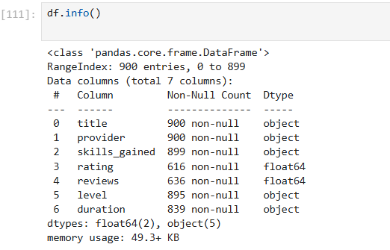
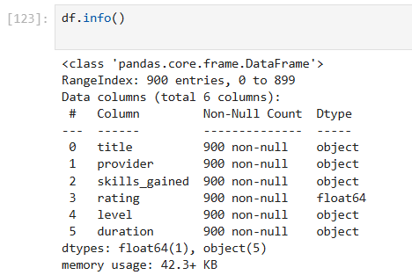
Data Cleaning:
Before
Removed unnecessary columns
Handled missing values
Converted data types
Removed duplicate records
Created new feature: skill_count
After

Slide 10
Types of Analysis:
Univariate Analysis
Bivariate Analysis
Multivariate Analysis
Statistical Hypothesis Testing

Slide 11
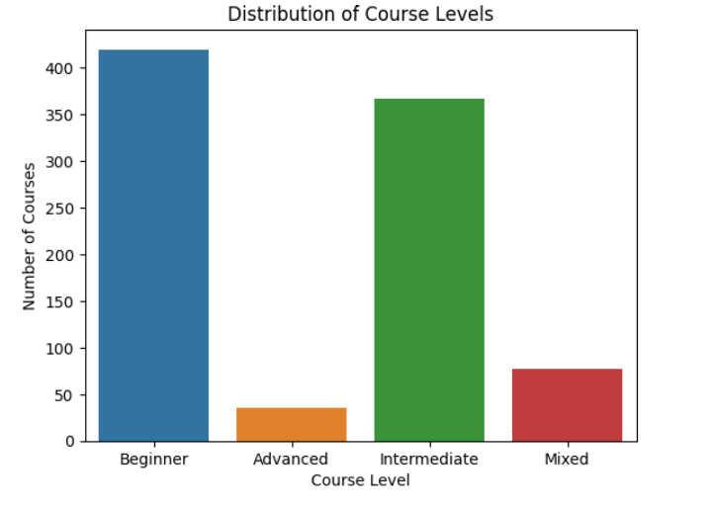
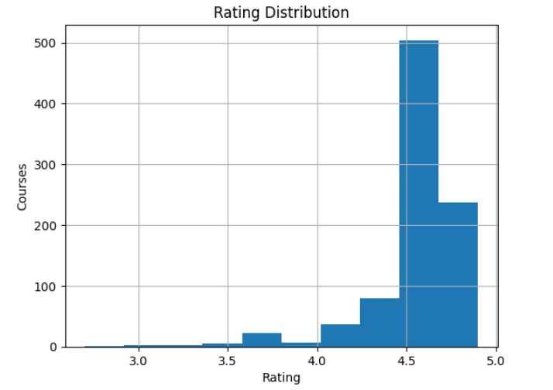
Univariate Analysis:
Most courses have ratings between 4.5 and 4.9, indicating high learner satisfaction.
Very few courses have ratings below 4.0, showing overall good course quality.
The distribution is left-skewed, meaning higher ratings are more common.
Beginner-level courses dominate the platform, making it beginner-friendly.
Intermediate courses form the second largest category.
Advanced-level courses are limited, indicating fewer specialized offerings.
Mixed-level courses are comparatively fewer but support flexible learning paths.

Slide 12
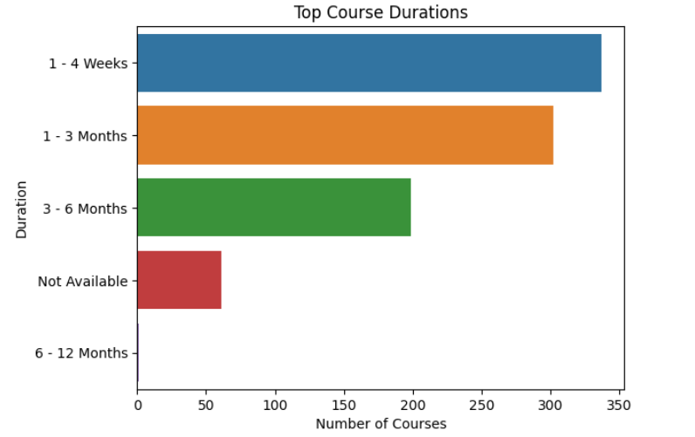
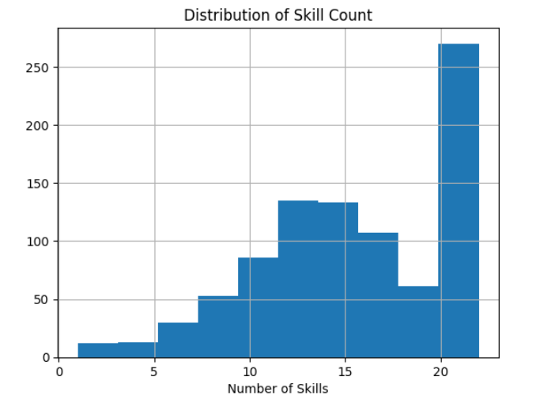
Most courses fall within 1–4 weeks and 1–3 months, indicating a preference for short-term learning.
Long- duration courses (6-12) months are very limited on the platform.
Learners are encouraged to complete courses quickly with focused learning goals.
Majority of courses offer between 10 and 20 skills.
Very few courses provide less than 5 skills, indicating comprehensive course design.
Higher Skills coverage suggests a strong focus on practical and job-ready learning.
Courses are structured to deliver multiple competencies within a single program.

Slide 13
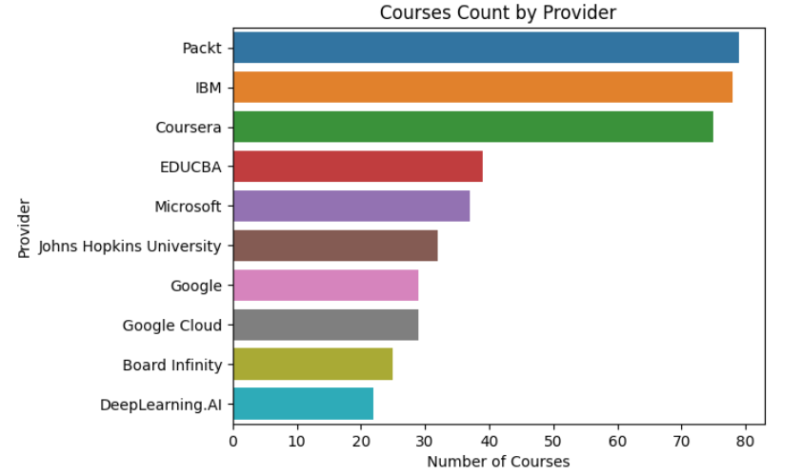
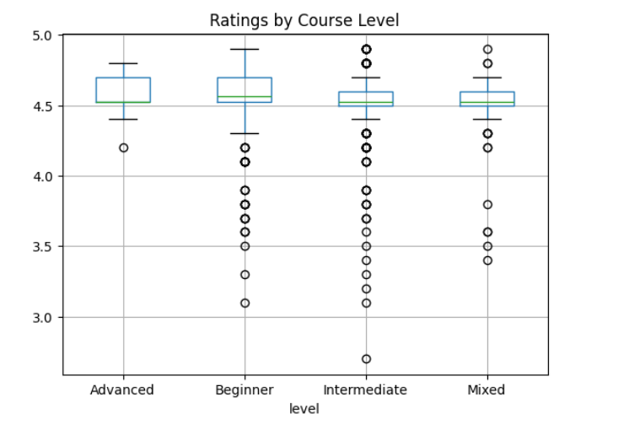
Bivariate Analysis:
Packt and IBM offer the highest number of courses on the platform.
Major organizations like Coursera, Microsoft, and Google also contribute significantly.
The distribution shows that a few top providers dominate course offerings.
This indicates strong institutional participation in online education.
Ratings across all Course levels remains consistently High, mostly above 4.4.
Beginner and Intermediate courses show slightly wider variation in ratings.
Advanced Courses tend to have more stable and consistent ratings.

Slide 14
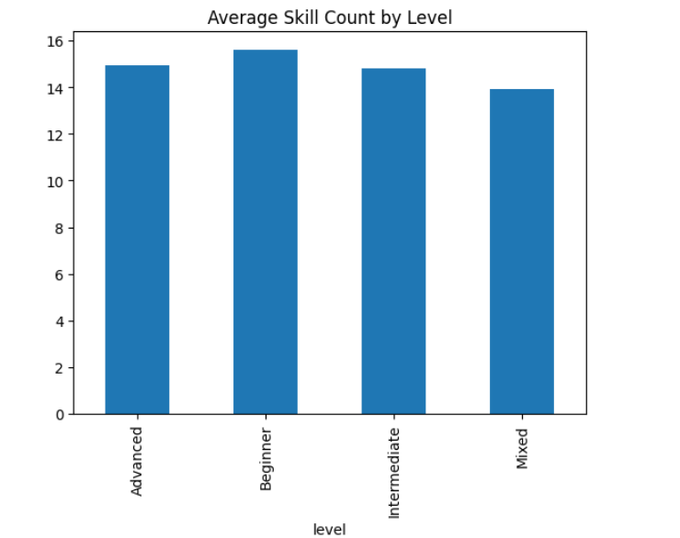
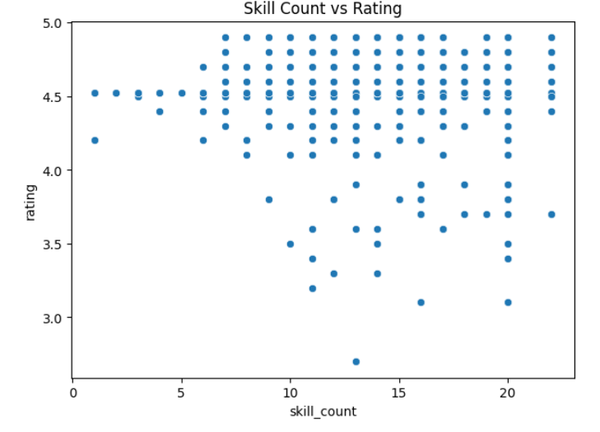
Ratings remain mostly between 4.3 and 4.9, regardless of skill count.
No strong linear relationship is observed between number of skills and rating.
Courses with both low and high skill counts can achieve high ratings.
Learner satisfaction depends more on content quality than quantity of skills.
Beginner courses having the highest average no of skills.
Intermediate and Advanced courses offer a balanced skill count.
Mixed-level courses slightly cover fewer skills compared to others

Slide 15
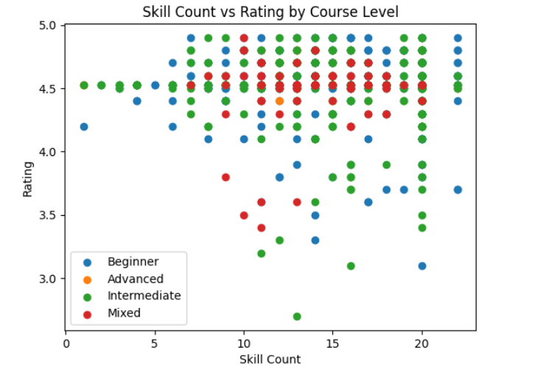
Multivariate Analysis:
Ratings remain consistently high (above 4.0) across all course levels.
Courses with both low and high skill counts can achieve strong ratings.
Beginner and Intermediate courses show a wider spread in ratings.
Advanced courses tend to have more stable and less variable ratings.
Mixed-level courses show moderate variation due to diverse learner backgrounds.

Slide 16
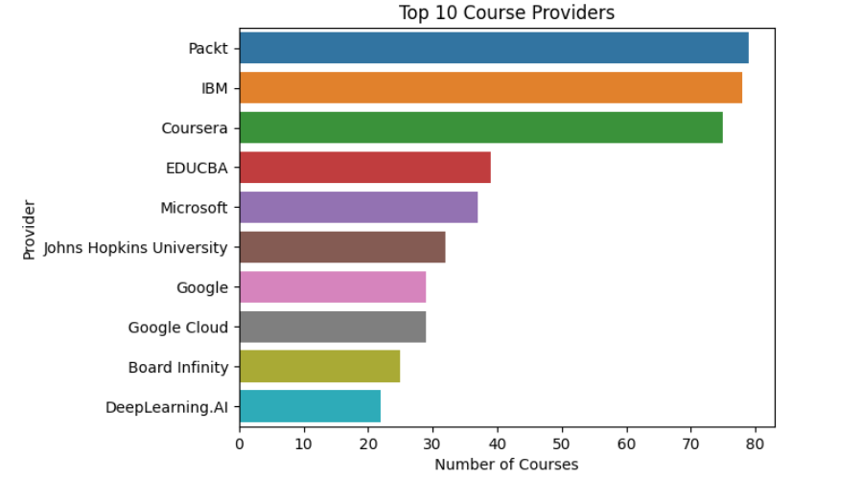
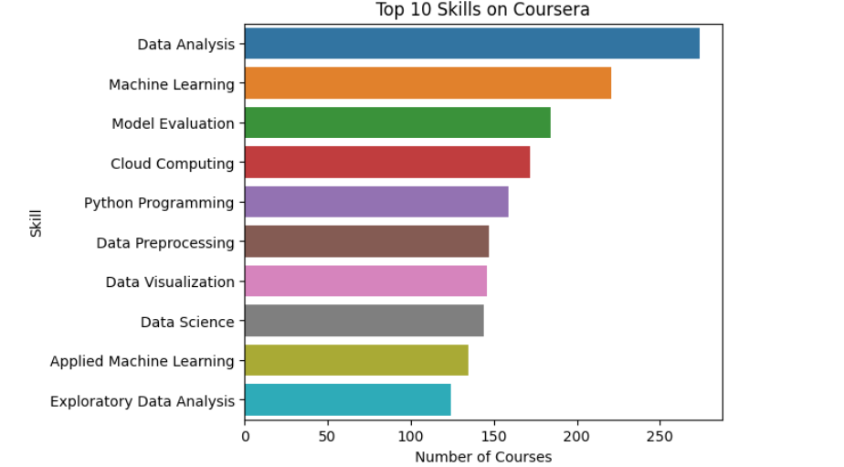
Key Visualizations:

Slide 17
Evaluation (Hypothesis Testing):
Course Level vs Rating
Null Hypothesis (H₀):
There is no significant difference in average course ratings across different course levels
Alternative Hypothesis (H₁):
There is a significant difference in average course ratings across different course levels.
• A one-way ANOVA test was performed to compare the mean ratings among different course levels
• The test result showed no statistically significant difference in average ratings between course levels.
Since the p-value was greater than the significance level (α = 0.05), the null hypothesis (H₀) was accepted.

Slide 18
Evaluation (Hypothesis Testing):
Skill Count vs Course Rating
Null Hypothesis (H₀):
There is no significant relationship between the number of skills covered in a course and its rating.
Alternative Hypothesis (H₁):
There is a significant relationship between the number of skills covered and course rating.
•Pearson Correlation Test was used to measure the relationship between skill count and rating
•The correlation value indicated a weak relationship between skill count and rating.
• The p-value was greater than 0.05, indicating no strong statistical association..

Slide 19
Evaluation (Hypothesis Testing):
Average Course Rating vs Benchmark (4.5)
Null Hypothesis (H₀):
The average Coursera course rating is less than or equal to 4.5.
Alternative Hypothesis (H₁):
The average Coursera course rating is greater than 4.5.
A one-sample t-test was performed using 4.5 as the benchmark rating.
The test result showed that the mean course rating is significantly higher than 4.5.
Since the p-value was less than the significance level (α = 0.05), the null hypothesis (H₀) was rejected.

Slide 20
Challenges:
Dynamic content loading caused scraping delays.
Inconsistent HTML structure across course cards.
Missing values in skills, duration, and ratings.
Difficulty in separating combined text fields.
Ratings were very close, making visualization challenging.

Slide 21
Key Insights:
Majority of courses are Beginner level.
Most courses have ratings above 4.5.
IBM and Packt are major course providers.
Course duration has little impact on rating.
Content quality matters more than quantity.

Slide 22
Conclusion:
This project successfully demonstrated an end-to-end data analytics workflow using real-world Coursera course data.
The dataset was collected through web scraping, cleaned, and analyzed using exploratory data analysis techniques.
Various visualizations helped uncover meaningful insights related to course providers, ratings, skill demand, and course structure.
Hypothesis testing further validated assumptions using statistical methods, enabling data-driven conclusions.

Slide 23


Slide 24

THANK YOU

